Slide 1

Process Discovery & Event Prediction using Deep Learning
A CNN-BASED APPROACH TO LOG ANALYSIS
SIDDHANT DANI
AUGUST 6, 2024

Slide 2
INTRODUCTION
Process Discovery:
Process discovery is a key aspect of process mining, focusing on identifying, mapping, and understanding business processes from event logs.
It helps organizations gain insights into their workflows, uncover inefficiencies, and ensure compliance.
Event Logs: Event logs are records of events or activities that occur within a process, captured in a structured format. They provide a detailed history of the execution of the process.
IMPORTANCE:
Accurate process discovery is crucial for:
Improving Efficiency: Identifying bottlenecks and streamlining operations.
Enhancing Transparency: Providing a clear view of operations for stakeholders.

Slide 3
OBJECTIVES
To leverage deep learning techniques, specifically Convolutional Neural Networks (CNNs), for event prediction and log classification.
Improved Log Analysis: Develop a CNN-based model to automate the analysis of event logs, enhancing accuracy and efficiency.
Trace Classification: Implement a method to classify and compare traces from test and base logs, determining which fits the process model better.
Enhance Predictive Capabilities: Utilize probability distributions of events derived from training data to predict future events accurately.

Slide 4
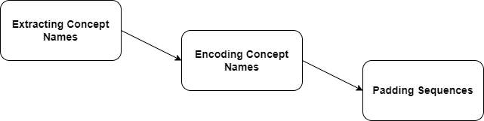
Dataset and Preprocessing
Source of Event Logs: Event logs were sourced from the ICPM 2023 Process Discovery Contest dataset, which includes 384 training logs, 96 test and 96 base logs.
These logs contain records of events that occur within a process, captured in a structured format.
Fig. 1: A trace of events
Fig. 2: Preprocessing Steps

Slide 5
Dataset and Preprocessing
Extracting Concept Names:
  Concept names refer to the specific activities or events recorded in the event logs.
  Extracting these names is crucial as they represent the core actions within the process, providing a sequence of activities that need to be analyzed.
Encoding Activity Names:
  Encoding activities is the process of converting textual activity names into numerical indices.
  This conversion facilitates the processing of sequential data by the neural network, allowing it to recognize patterns and learn from the sequences
Padding sequences:
  Padding sequences involves adjusting the length of encoded activity sequences to a uniform length.
  This is done by adding a special padding value (zeros) to shorter sequences so that all input sequences have the same length.

Slide 6
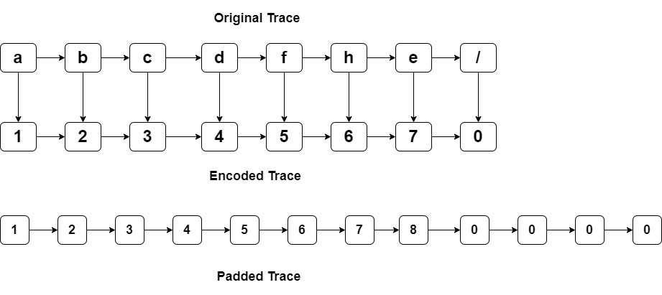
Dataset and Preprocessing

Slide 7
Training Process and Model
A Convolutional Neural Network was chosen for its ability to capture patterns and dependencies in sequential data. CNNs are particularly effective at identifying local patterns and can be trained to recognize complex structures within the sequences.
Fig. Proposed CNN Model Architecture

Slide 8
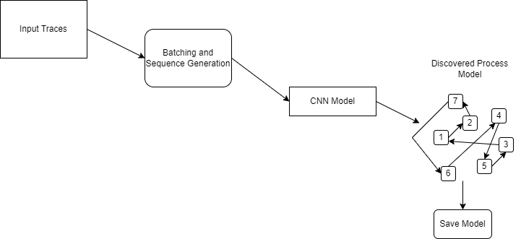
Training Process and Model

Slide 9
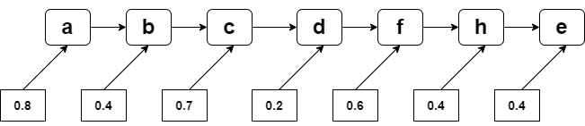
Training Process and Model
The training process involved feeding the pre-processed event sequences into the CNN model.
Sequence Generator: To efficiently handle the large dataset, a sequence generator was used. This generator yields batches of data, allowing the model to train on smaller subsets of the data at a time, which is particularly useful for large datasets.
Batch Sizes: Training was performed using a specific batch size to balance between memory constraints and convergence speed. The batch size used is 32.
Probability Distributions: The model learned to generate probability distributions for each event in the sequence, capturing the likelihood of various activities occurring.

Slide 10
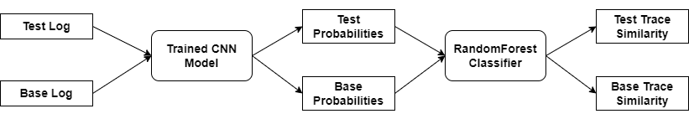
Classification and Evaluation
The CNN model processes each sequence and outputs a probability distribution for each sequence.
These probabilities represent the model's confidence in predicting the occurrence of each event in the sequence.
For each trace in the test log and the base log a probability distribution is generated by the model.
RandomForestClassifier:
We chose RandomForestClassifier for its robustness and ability to handle high-dimensional data.
The classifier is trained on the feature vectors created from both test and base logs.
Fig. Classification Process

Slide 11
Classification and Evaluation
Decision Making:
After training, the classifier is used to predict the probability that a given sequence belongs to the test log rather than the base log.
For each sequence, the classifier outputs a similarity score between 0 and 1, indicating the likelihood that the sequence fits the model of the test log.
If the similarity score for a test trace is higher than for a corresponding base trace, it is considered a better fit for the model.
Trace 1: Test Similarity = 0.6200, Base Similarity = 0.4000
Trace 2: Test Similarity = 0.6043, Base Similarity = 0.3000
Trace 4: Test Similarity = 0.4323, Base Similarity = 0.4853
Trace 5: Test Similarity = 0.2695, Base Similarity = 0.3970
Trace 6: Test Similarity = 0.4853, Base Similarity = 0.4853

Slide 12
Classification and Evaluation
Metrics:
The model’s performance was evaluated using several key metrics such as Precision, Recall, and F-score.
Overall Results:
Total Average F-score: 0.9183
Total Average Precision: 0.9275
Total Average Recall: 0.9251
The high values for Precision, Recall, and F-score indicate that the trained models are performing well in differentiating test and base logs.

Slide 13
Challenges and Solutions
Time Consuming:
The entire process of training models, extracting probabilities, and performing classification was extremely time-consuming.
Because of the huge size of the training dataset, on average just training the models took about a week and then for classification another day.
After a lot of discussions and code changes, we were able to optimize the code to reduce the execution time. Currently, we can conclude the entire process in about 3 days.
CAIR Cluster: The Centre for Analytics, Informatics, and Research (CAIR) is a high-performance computing center with the capacity to rapidly process and analyze vast amounts of data and provide secure storage with off-site backups.
Contact: cair-support@mun.ca

Slide 14
Challenges and Solutions
The Original Idea:
The initial idea was to predict the probability for each event in a sequence and then decide based on the multiplied probabilities, whether the trace fits the model better or not.
But with this approach we are facing an issue with training the classifier, as the multiplied probabilities sometimes are so small that they are close to zero.
Also, for the higher values the classifier performance is not great.
Hence, we shifted to an approach to predict the probabilities over the entire sequence for each sequence in base and test logs.
And now we are using the aggregated probabilities and features like mean and variance for classification.
This approach simplified the complexity of the prediction process and still maintained the performance.
It also brought down the time required for the prediction process from a day to 4 hours.

Slide 15
Conclusion
The project aimed to enhance the process of predicting and classifying event sequences from logs using advanced machine-learning techniques.
We developed a CNN-based model to extract probabilities for each event in a sequence, forming the foundation of our classification approach.
By using RandomForestClassifier, we developed a robust system to compare test logs against base logs, achieving high accuracy and reliable classification.
The model demonstrated excellent performance, achieving an average F-score of 0.9183, precision of 0.9275, and recall of 0.9251.
These metrics indicate a strong balance between precision and recall, ensuring the identification of relevant events and minimizing false positives.

Slide 16
Key Learning Outcomes
Event Log and Sequence Data Handling: Gained expertise in processing and analyzing event logs and sequence data.
Process Mining and Models: Acquired knowledge about process mining techniques and process models.
Process Discovery with CNN/LSTM and PM4PY: Explored how convolutional neural networks (CNN), long short-term memory (LSTM), and PM4PY can be utilized for process discovery.
Command Line and Shell Scripting on Linux: Improved skills in using command line interfaces and shell scripting.
Next Event Prediction: Understood the mechanisms of predicting the next event using probabilities.

Slide 17
Acknowledgments
Dr. Joerg Evermann, Associate Professor of Information Systems with the Faculty of Business Administration, Memorial University of Newfoundland.
“Discovering generative models from event logs: data-driven simulation vs deep learning”, Manuel Camargo, Marlon Dumas and Oscar González-Rojas, July 2021
“Process Mining and Deep Neural Network Approach for the Prediction of Business Process Outcome”, B. Kamala; B. Latha, May 2022
“A Process Mining Framework Based on Deep Learning Feature Fusion”, Canming Xia, Mali Xing, Yanyan Ye, Shenghuang He, October 2022
“A process mining- deep learning approach to predict survival in a cohort of hospitalized COVID‐19 patients”, M. Pishgar, S. Harford, J. Theis, W. Galanter, J. M. Rodríguez-Fernández, L. H Chaisson, Y. Zhang, A. Trotter, K. M. Kochendorfer, A. Boppana and H. Darabi, July 2022
“Predicting performances in business processes using deep neural networks”, Gyunam Park, Minseok Song, February 2020

Slide 18
Thank You!!!

